Slide 1






Finding
Research Resources
and Referencing
lib.uts.edu.au
utslibrary
utslibrary

Slide 2

Notes:
As you probably know, we have print books and ebooks in the Library.
We can also get you access to 7 MILLION books through BONUS+
If the book you want isn’t there, we can get InterLibrary Loans, or you can suggest a new book for us to purchase.
Google Books (books.google.com) is also a good way of finding new books, as it searches the full text of a book (and sometimes has a preview available)

Slide 3

Notes:
Features: Colourful, no references to sources – sometimes no author listed (anonymous), advertisements. One week they’re writing about the Beatles, the next week they’re writing about which shade of lipstick is the best for Spring.

Slide 4

Notes:
Written by people that are working in the field, and aimed at a certain profession. Sometimes no references to their sources, or may just be discussing something of interest to the profession, such as copyright ownership of the Beatles songs, and how licensing them for use in rap music can be achieved. May still feature colour images, inforgaphics and advertisements, but considered to be more reliable than popular journals, as they are written with a professional audience in mind. Sometimes no author provided at all.

Slide 5

Notes:
The least visually appealing of them all (as a general rule). They generally have the following features: An abstract or short summary of the paper, an author, and their affiliation (where they work), and an extensive list of references used as evidence of their research. This means that their work can be checked by the reader, and you are able to better know if it is a trustworthy source.
Peer reviewed articles go through a process where a panel of experts evaluates the paper and looks for weaknesses. These weaknesses must be addressed/fixed before the paper is published. This is why academic articles are considered the most reliable source.
Good databases for you -
ProQuest Science & Technology
INSPEC (Institution of Engineering and Technology)
IEEE Xplore
ACM Digital Library
SCOPUS (Elsevier)
More IT databases

Slide 6

Notes:
Works that come from conferences can be a full conference paper, in the style of an academic journal paper (it may or may not be peer reviewed), a keynote or recording of a presentation, a poster, or it may only be the published abstract, or short summary. Depending on the type of conference publication, it may be very easy, or impossible to find full text. Let our UTS Library staff look for you using InterLibrary Loans (https://www.lib.uts.edu.au/borrow/borrowing-other-libraries#tabs-3)

Slide 7

Notes:
Industry or company information can be found in a number of places – Patents, industry reports and legislation, standards, and statistics.

Slide 8
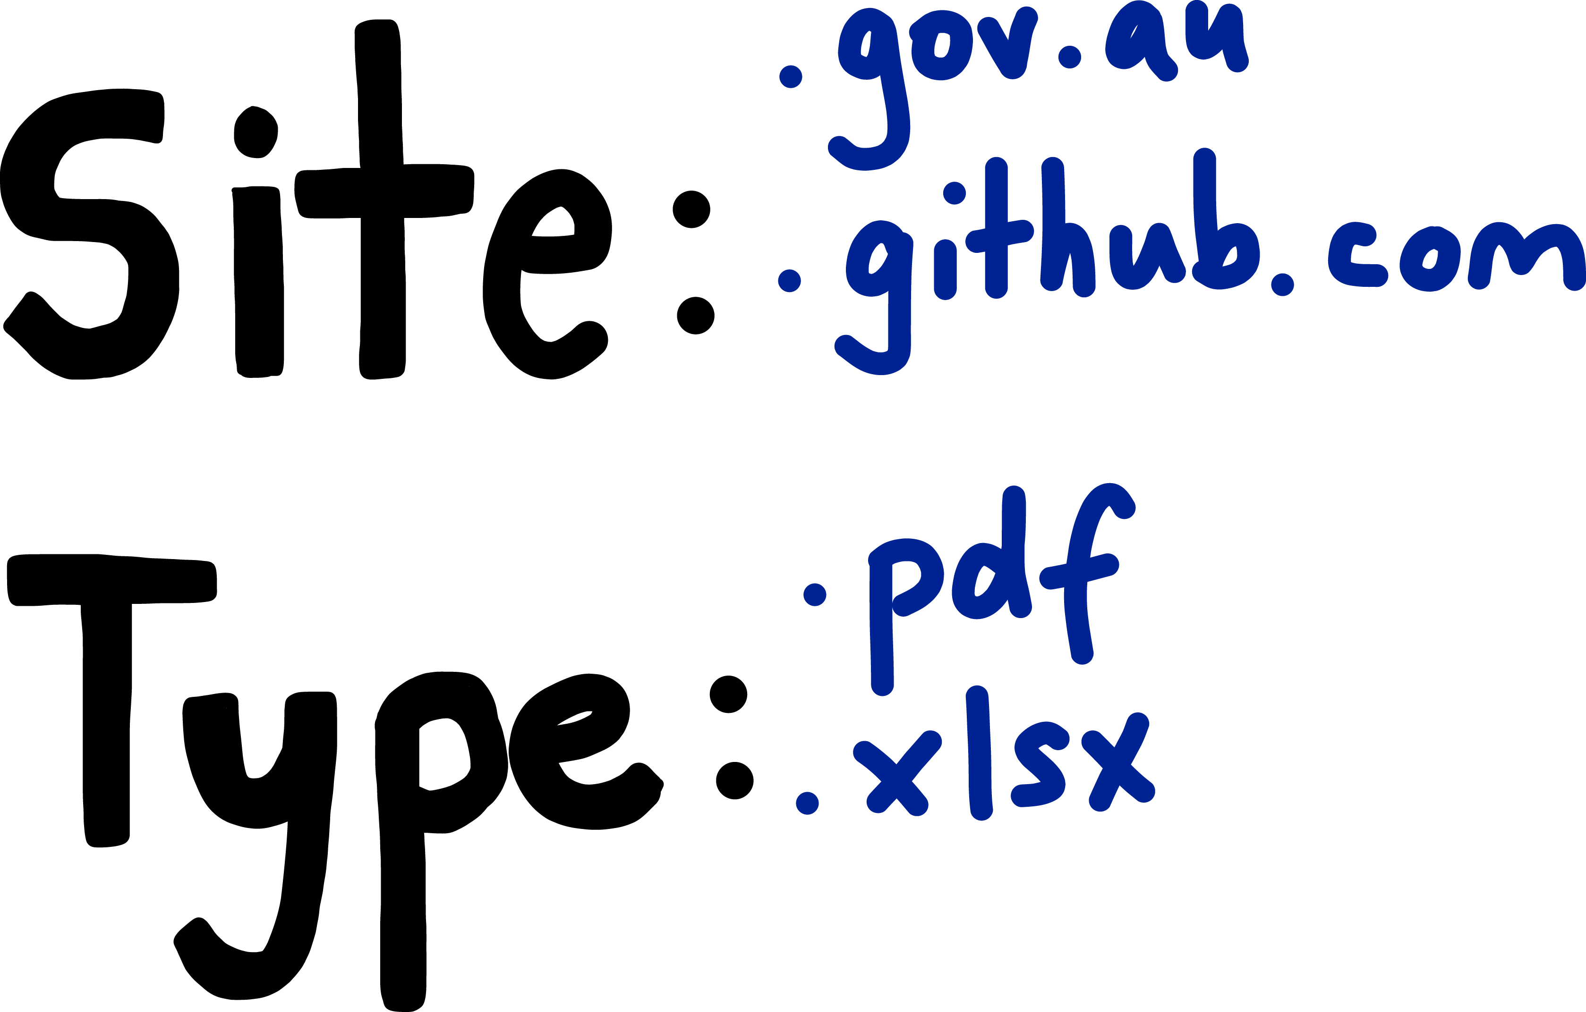
Notes:
Google trick. Do your regular search (eg. “information security”) and then add site:.gov.au at the end. The site: part is a command to Google – only return websites that are from this domain.
Add type: to your search with a file extension to only return files that have that extension.
This will help you get useful results (especially if you’re after statistics, using site:abs.gov.au)

Slide 9

Have questions?
Ask a librarian
Look at the Study Guide
Library Science and Technology Team
Book a workshop in Week 4 - compulsory!
lib.uts.edu.au
utslibrary
utslibrary
This work is licensed under a Creative Commons Attribution 4.0 International License.

